Slide 1

MLOps (Applied Data Science) Session 2 Topics – Git & Github
Dr. Nilay Karade
Program Manager

Slide 2
MLOps (Machine Learning Operations)
Definition: MLOps is a set of practices and tools that combine machine learning (ML) system development and machine learning system operations (DevOps). It aims to streamline and automate the entire ML lifecycle, including model development, testing, deployment, monitoring, and maintenance.
Key Components:
Version Control: Git and GitHub
Containerization: Docker
Model Registry: MLFlow
Benefits: MLOps improves collaboration, reproducibility, and reliability in ML projects, accelerating the development and deployment of models in production.

Slide 3
Agenda
Git & Github setup
https://git-scm.com/book/en/v2/Getting-Started-Installing-Git
github.com
Git commands
config
init
status
add
commit
log
diff
rm
gitignore
branch
checkout
merge
remote
push
pull

Slide 4
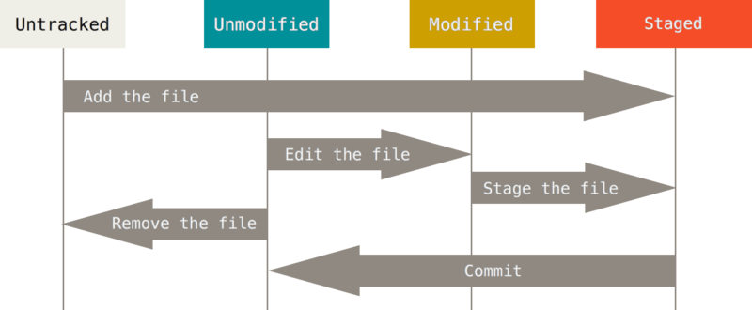
Recording Changes to the Repository
SOURCE: https://git-scm.com/book/en/v2/Git-Basics-Recording-Changes-to-the-Repository

Slide 5
config:
git config is used to configure Git settings, such as user name and email.
Example:
git config --global user.name "Your Name"
git config --global user.email "youremail@example.com"

Slide 6
init:
git init initializes a new Git repository in the current directory.
Example:
git init

Slide 7
status:
git status shows the current state of your working directory and staging area. It displays files that are modified, untracked, or staged.
Example:
git status

Slide 8
add:
git add stages changes, preparing them for the next commit.
Example:
git add filename.txt
git add --all

Slide 9
commit:
git commit records staged changes as a new commit in the Git history.
Example:
git commit -m "Add new feature“
git add -A && git commit -m "Your Message"

Slide 10
Task 1
Create new file and apply following git commands
Create a file
Check status of a file
add file to staging area
Check status of a file
Modify file content
Check status of a file
add file to staged area
Apply commit

Slide 11
log:
git log displays a history of commits in the repository, including commit messages, authors, and commit IDs.
Example:
git log

Slide 12
diff:
git diff shows the differences between the working directory and the last committed version.
Example:
git diff

Slide 13
rm:
git rm removes a file from the working directory and stages the removal for the next commit.
Example:
git rm filename.txt

Slide 14
.gitignore:
.gitignore is a file where you specify files or directories that should be ignored by Git (e.g., temporary files, logs).
Example: Create a .gitignore file with contents like:
bash
Copy code
*.log
temp/

Slide 15
branch:
git branch lists all branches in the repository, showing the current branch with an asterisk.
Example:
git branch

Slide 16
checkout:
git checkout switches to a different branch or commit. It's used for branch management and code navigation.
Example:
git checkout new-feature-branch

Slide 17
merge:
git merge combines changes from one branch into another. It's used to integrate feature branches into the main branch.
Example:
git merge feature-branch

Slide 18
remote:
git remote shows a list of remote repositories connected to your local repository.
Example:
git remote -v

Slide 19
push:
git push sends your local commits to a remote repository, typically on a service like GitHub or GitLab.
Example:
git push origin main

Slide 20
Jamboard activity
https://jamboard.google.com/d/1HBB5NYy8-sbC8NAtdmd8d3OLo1fMkE1K1HfpUSiuL58/edit?usp=sharing

Slide 21
Summary
Git & Github setup
Git commands
config
init
status
add
commit
log
diff
rm
gitignore
branch
checkout
merge
remote
push

